Slide 1
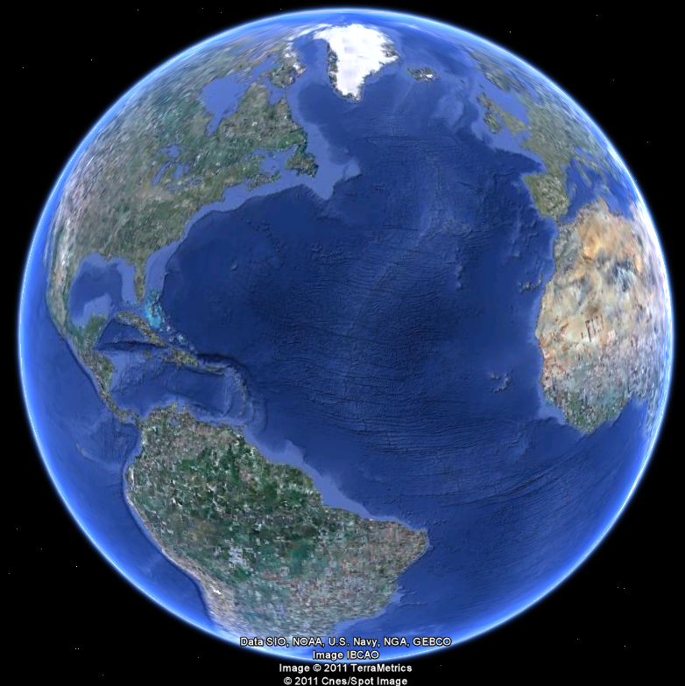
APEC 100 Sustainable Development
Economics of Private and Public Goods

Slide 2
What is Economics?
Economics is the science that examines the relationship between resource supply and demand.
Economics is the study of allocating scarce resources to satisfy unlimited wants
Basic assumption: people make choices primarily motivated by self-interest
Economics studies people and society’s behavioral choices.
In comparison:
Ecology is the science that provides understanding of resource renewal rates.
Policy is the means by which societies organize guidance in balancing supply and demand based on ecological and economic information.

Slide 3
Environmental & Resource Economics
Resources have competing uses
In the present time period
In the future
We cannot have it all.
Environmental and resource economics
How can we best distribute natural resources to provide more total benefit to people?
Hard choices
No single best decision is available for all people
Otherwise, it would have occurred.
Values matter

Slide 4
Rival and Excludable -- Weimer and Vining (1992)
Rivalry means that what one person consumes cannot be consumed by anyone else.
Non-rival: One person’s consumption of the public good does not diminish the amount of public good available to others to consume. {air}
Excludability means that some particular person has exclusive control over the good.
Non-excludability: A good is excludable if it is feasible and practical to selectively allow consumers to consume the good. {key}

Slide 5
 | RIVAL | NON-RIVAL
EXCLUDABLE
NON-EXCLUDABLE

Slide 6
 | RIVAL | NON-RIVAL
EXCLUDABLE | Private Goods Strawberries Blue Jeans
NON-EXCLUDABLE

Slide 7
Private Goods: Markets and Public Interests
Adam Smith’s Wealth of Nations popularized the “invisible hand” and praised the basis of capitalism:
An individual who intends only his own gain, such as the butcher and baker, is “led by an invisible hand to…promote the public interest.”

Slide 8
Markets and Public Interests
Environmentalists are some of the loudest voices against capitalism and trade.
The invisible hand doesn’t seem to promote a healthy environment.
Is this just another case of Malthusian thinking or the Ehlich and Simon bet on resource prices?
In other words, are these complaints misguided?

Slide 9
Can profit incentives protect natural resources?
Highly dependent on property rights
Property rights include rights to own, use, buy, and trade natural resources
Property rights are protected streams of benefits
Why do property rights promote natural resource conservation?
Property rights create incentives to manage resources efficiently—mainly sustainably
Are all instances of degradation associated with missing/incomplete property rights?
9

Slide 10
 | RIVAL | NON-RIVAL
EXCLUDABLE | Private Goods Strawberries Blue Jeans | Club Goods Exercise gym Pay-per-view TV
NON-EXCLUDABLE

Slide 11
 | RIVAL | NON-RIVAL
EXCLUDABLE | Private Goods Strawberries Blue Jeans | Club Goods Exercise gym Pay-per-view TV
NON-EXCLUDABLE | Common Pool Resources Fish in the ocean Roads in rush hour Pollution in a lake

Slide 12
Externalities
External costs occur when a decision maker chooses a level of production or consumption and does not fully bear the costs of his or her actions.
Party A makes a decision, which harms Party B, with no compensation and Party B had no say
Inefficient allocation
Frequently happens in natural resource setting—less so in other situations
What real-world examples can you think of?

Slide 13
 | RIVAL | NON-RIVAL
EXCLUDABLE | Private Goods Strawberries Blue Jeans | Club Goods Exercise Gym Pay-per-view TV
NON-EXCLUDABLE | Common Pool Resources Fish in the ocean Roads in rush hour Pollution in a lake | Public Goods Lab Experiment Clean Air Street Signs

Slide 14
A Parable
Once, a long time ago in a poor village in the famous Côte ďOr wine region of France, the village Priest announced his retirement after decades of service.
The villagers each wanted to give him a gift to help ease his life in retirement. But alas, they were poor and had no money to spare.
The village elders met and decided that while they were individually poor in monetary terms, collectively they were rich in grapes and winemaking skills. Together, if each household donated a carafe of their best wine from their fields, they could amass a barrel that the priest could sell and adequately fund a long retirement.
A cask was placed in the village centre, and each night, after a long day of toil, the villagers brought their carafes to the barrel and eventually filled it to the brim...
What happened when the Priest opened the cask?

Slide 15
The Science of Experimental Economics
Experimental economics seeks to study phenomenon that is observed in the real world in a controlled environment and relies upon the scientific principals of replicability.
The 2002 and 2009 Nobel Prizes in Economics were awarded for work using experimental economics methods.
Experiments involve participants making choices with monetary outcomes, not just hypothetical questions common to questionnaires and focus groups.
Experimental economics often involves auctions for products (no deception allowed):
Auctions provide a richer dataset on people’s willingness-to-pay than yes/no decisions on posted prices, such as those found in a supermarket.
In this course, unless the otherwise stated, all of the experiments are designed for teaching purposes and not for active research.

Slide 16
Public Goods: Results from the Experiment

Slide 17
A Parable Revisited
What happened when the Priest opened the cask?

Slide 18
Public Goods: What to Do?
1. Claim that the problem is not important enough for government intervention.
2. Government provided. Funded by taxes and fines.
3. Alternative Voluntary Mechanisms and/or use Behavioral Economics:
Use psychology to affect behavior.
Use social norms to increase voluntary contributions.
Center for Behavioral Economics and Agri-Environmental Policy (CBEAR)

